Slide 1
SEP760 Cyber Physical Systems
Summer 2025
Deep / Machine Learning
W. Booth School of Engineering, McMaster University
Dr. Anwar Mirza
mirzaa24@mcmaster.ca

Slide 2
Least Squares Curve Fitting
and Regression Analysis

Slide 3
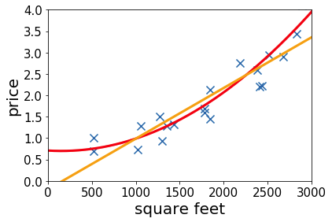
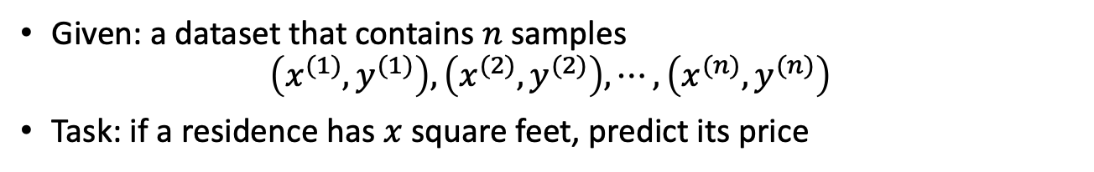
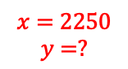
Housing Price Prediction
Given: a dataset that contains $n$ samples
$$\left(x^{(1)},y^{(1)}\right),\left(x^{(2)},y^{(2)}\right), ⋯,\left(x^{(n)},y^{(n)}\right)$$
Task: if a residence has $x$ square feet, predict its price
Quadratic fit
Linear fit
$$x=2250$$
$$y=?$$

Slide 4
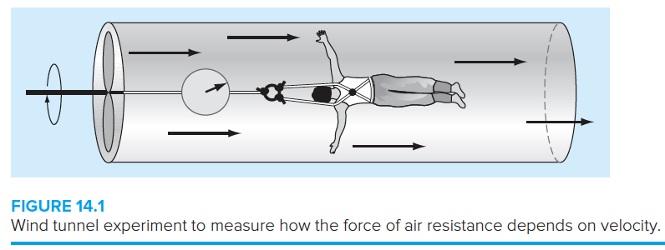
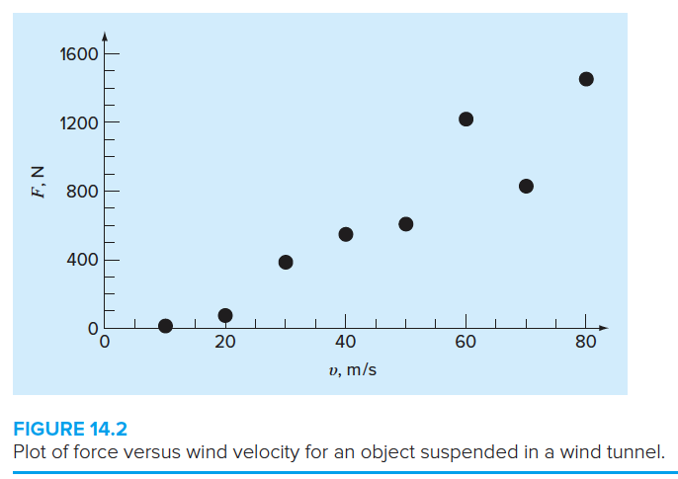
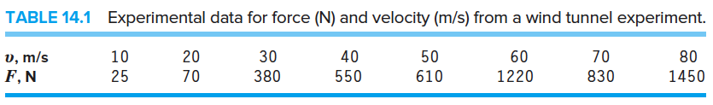

Wind Tunnel Experiments
Air drag is modelled as the upward
Force acting on a bungee jumper:
$$F_{U}=c_{d}v^{2}$$
What is the best line or curve that fits this data?

Slide 5
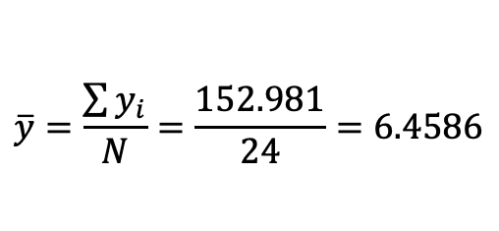
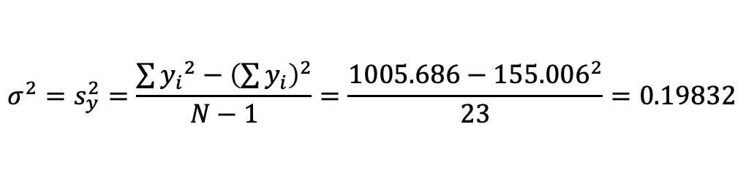
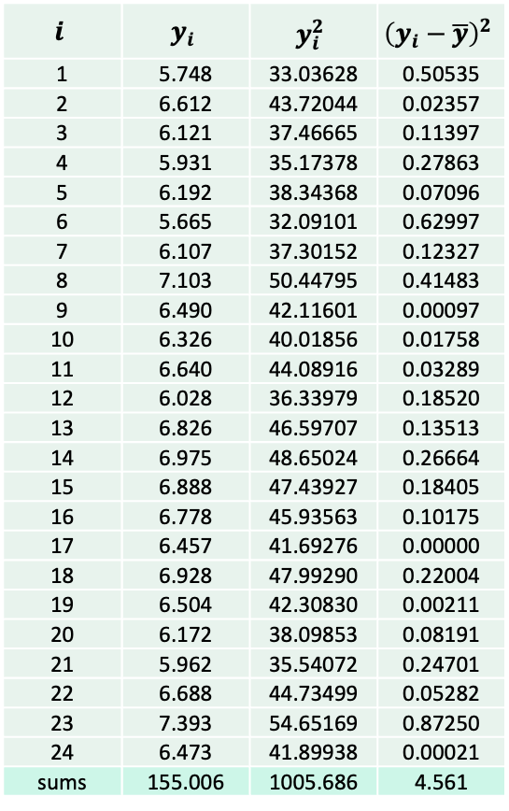
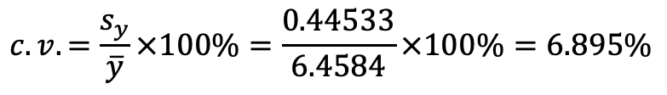
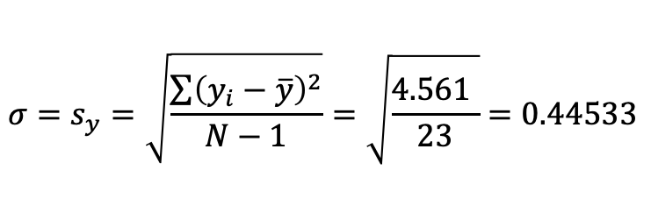
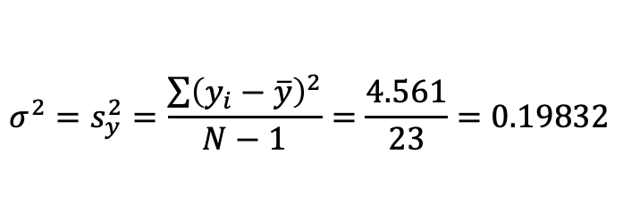
Example 14.1 Simple Statistics of a Sample
Statistics Review
5.748 | 6.192 | 6.490 | 6.826 | 6.457 | 5.962
6.612 | 5.665 | 6.326 | 6.975 | 6.928 | 6.688
6.121 | 6.107 | 6.640 | 6.888 | 6.504 | 7.393
5.931 | 7.103 | 6.028 | 6.778 | 6.172 | 6.473
Mean is a measure of expectation value or location
$$\overline{y}=\frac{\sum{y_{i}}}{N}=\frac{152.981}{24}=6.4586$$
Mean
$$i$$ | $$y_{i}$$ | $$y_{i}^{2}$$ | $${\left(y_{i}−\overline{y}\right)}^{2}$$
1 | 5.748 | 33.03628 | 0.50535
2 | 6.612 | 43.72044 | 0.02357
3 | 6.121 | 37.46665 | 0.11397
4 | 5.931 | 35.17378 | 0.27863
5 | 6.192 | 38.34368 | 0.07096
6 | 5.665 | 32.09101 | 0.62997
7 | 6.107 | 37.30152 | 0.12327
8 | 7.103 | 50.44795 | 0.41483
9 | 6.490 | 42.11601 | 0.00097
10 | 6.326 | 40.01856 | 0.01758
11 | 6.640 | 44.08916 | 0.03289
12 | 6.028 | 36.33979 | 0.18520
13 | 6.826 | 46.59707 | 0.13513
14 | 6.975 | 48.65024 | 0.26664
15 | 6.888 | 47.43927 | 0.18405
16 | 6.778 | 45.93563 | 0.10175
17 | 6.457 | 41.69276 | 0.00000
18 | 6.928 | 47.99290 | 0.22004
19 | 6.504 | 42.30830 | 0.00211
20 | 6.172 | 38.09853 | 0.08191
21 | 5.962 | 35.54072 | 0.24701
22 | 6.688 | 44.73499 | 0.05282
23 | 7.393 | 54.65169 | 0.87250
24 | 6.473 | 41.89938 | 0.00021
sums | 155.006 | 1005.686 | 4.561
Variance
$$σ^{2}=s_{y}^{2}=\frac{\sum{{\left(y_{i}−\overline{y}\right)}^{2}}}{N−1}=\frac{4.561}{23}=0.19832$$
Standard Deviation is a measure of the spread around the mean
Standard
Deviation
$$σ=s_{y}=\sqrt{\frac{\sum{{\left(y_{i}−\overline{y}\right)}^{2}}}{N−1}}=\sqrt{\frac{4.561 }{23}}=0.44533$$
Coefficient
of Variance
$$c.v.=\frac{s_{y}}{\overline{y}}×100\%=\frac{0.44533}{6.4584}×100\%=6.895\%$$
Small $c.v.$ means less dispersion of data around the mean value.
Variance (without calculating the mean):
$$σ^{2}=s_{y}^{2}=\frac{\sum{{y_{i}}^{2}}−{\left(\sum{y_{i}}\right)}^{2}}{N−1}=\frac{1005.686−{155.006}^{2}}{23}=0.19832$$

Slide 6

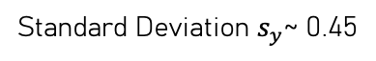
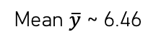
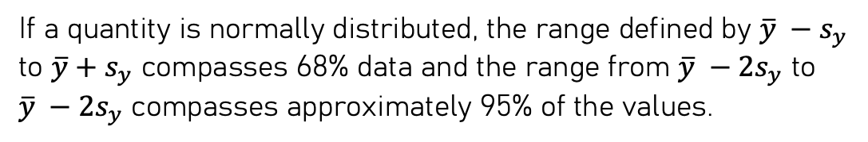

Statistics Review
i | yi | yi sorted | yi rounded | frequency
1 | 5.748 | 5.665 | 5.7 | 2
2 | 6.612 | 5.748 | 5.7
3 | 6.121 | 5.931 | 5.9 | 3
4 | 5.931 | 5.962 | 6.0
5 | 6.192 | 6.028 | 6.0
6 | 5.665 | 6.107 | 6.1 | 4
7 | 6.107 | 6.121 | 6.1
8 | 7.103 | 6.172 | 6.2
9 | 6.49 | 6.192 | 6.2
10 | 6.326 | 6.326 | 6.3 | 5
11 | 6.64 | 6.457 | 6.5
12 | 6.028 | 6.473 | 6.5
13 | 6.826 | 6.490 | 6.5
14 | 6.975 | 6.504 | 6.5
15 | 6.888 | 6.612 | 6.6 | 3
16 | 6.778 | 6.640 | 6.6
17 | 6.457 | 6.688 | 6.7
18 | 6.928 | 6.778 | 6.8 | 4
19 | 6.504 | 6.826 | 6.8
20 | 6.172 | 6.888 | 6.9
21 | 5.962 | 6.928 | 6.9
22 | 6.688 | 6.975 | 7.0 | 2
23 | 7.393 | 7.103 | 7.1
24 | 6.473 | 7.393 | 7.4 | 1
Histogram – Frequency Distribution
Number of Bins = 8
Mean $\overline{y}$ ~ 6.46
Bin width = (7.4-5.7)/8 = 0.2
Standard Deviation $s_{y}$~ 0.45
Mean ~ 6.46
Bell-shaped
curve
$$s_{y}$$
$$s_{y}$$
The histogram follows a bell-shaped curve around the mean
called the normal distribution.
If a quantity is normally distributed, the range defined by ${\overline{y} −s}_{y}$
to ${\overline{y}+s}_{y}$ compasses 68% data and the range from ${\overline{y} −2s}_{y}$ to
${\overline{y} −2s}_{y}$ compasses approximately 95% of the values.

Slide 7
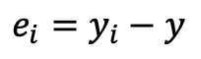
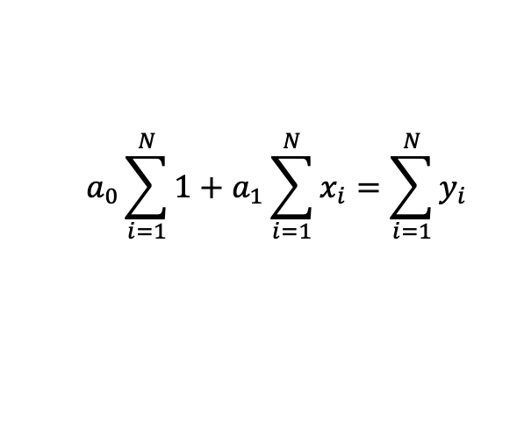
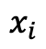
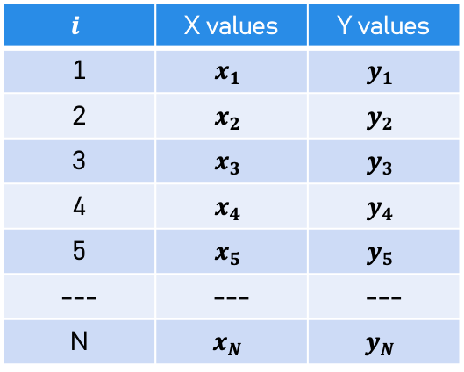
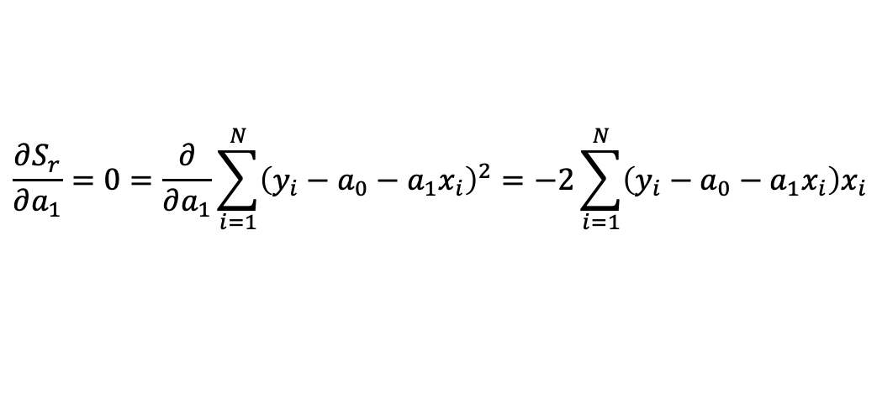
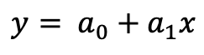
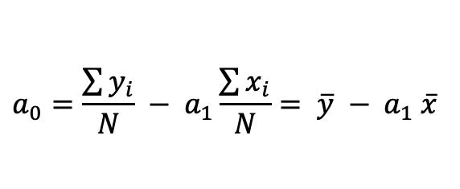
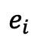
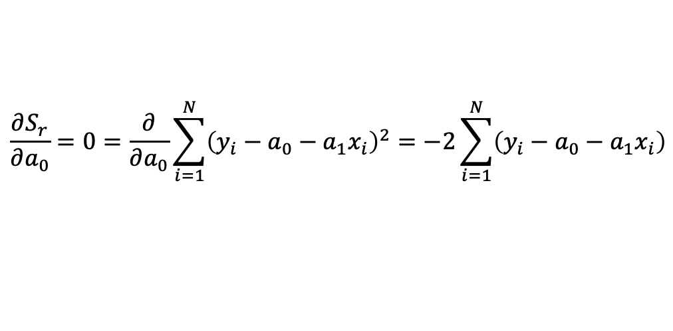
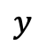
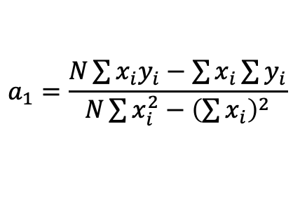
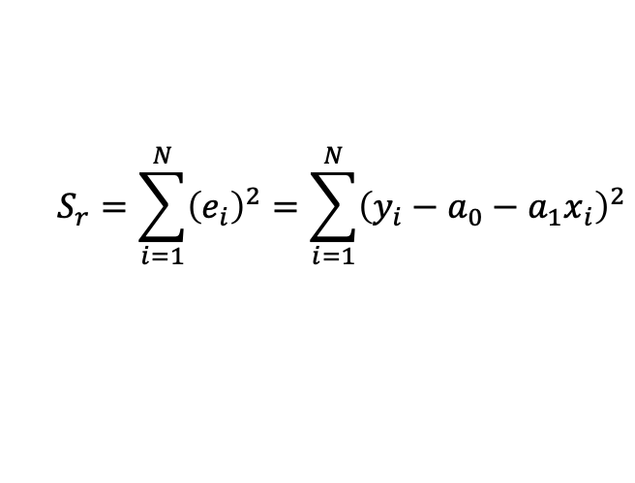
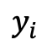
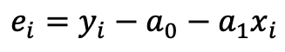
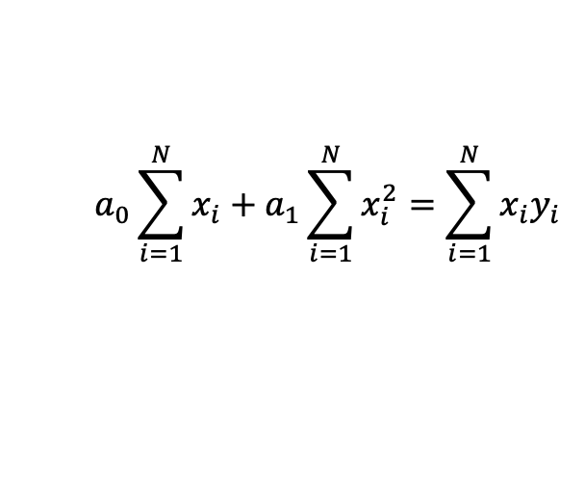
Linear (Least Squares) Regression
Approximation
$$y= a_{0}+a_{1}x$$
Error / residual
$$e_{i}=y_{i}−y$$
$$y_{i}$$
$$e_{i}$$
$$e_{i}=y_{i}−a_{0}−a_{1}x_{i}$$
$$y$$
Sum of the squares
of errors /residuals
$$S_{r}=\sum_{i=1}^{N}{{\left(e_{i}\right)}^{2}}=\sum_{i=1}^{N}{{\left(y_{i}−a_{0}−a_{1}x_{i}\right)}^{2}}$$
Minimize the sum of squares of residuals
$$x_{i}$$
$$\frac{∂S_{r}}{∂a_{0}}=0=\frac{∂}{∂a_{0}}\sum_{i=1}^{N}{{\left(y_{i}−a_{0}−a_{1}x_{i}\right)}^{2}}=−2\sum_{i=1}^{N}{\left(y_{i}−a_{0}−a_{1}x_{i}\right)}$$
$$i$$ | X values | Y values
1 | $$x_{1}$$ | $$y_{1}$$
2 | $$x_{2}$$ | $$y_{2}$$
3 | $$x_{3}$$ | $$y_{3}$$
4 | $$x_{4}$$ | $$y_{4}$$
5 | $$x_{5}$$ | $$y_{5}$$
--- | --- | ---
N | $$x_{N}$$ | $$y_{N}$$
$$\frac{∂S_{r}}{∂a_{1}}=0=\frac{∂}{∂a_{1}}\sum_{i=1}^{N}{{\left(y_{i}−a_{0}−a_{1}x_{i}\right)}^{2}}=−2\sum_{i=1}^{N}{\left(y_{i}−a_{0}−a_{1}x_{i}\right)x_{i}}$$
Normal Equations
$$a_{0}\sum_{i=1}^{N}{1}+a_{1}\sum_{i=1}^{N}{x_{i}}=\sum_{i=1}^{N}{y_{i}}$$
$$a_{1}=\frac{N\sum{x_{i}y_{i}}−\sum{x_{i}}\sum{y_{i}}}{N\sum{x_{i}^{2}}−{\left(\sum{x_{i}}\right)}^{2}}$$
$$a_{0}\sum_{i=1}^{N}{x_{i}}+a_{1}\sum_{i=1}^{N}{x_{i}^{2}}=\sum_{i=1}^{N}{x_{i}y_{i}}$$
$$a_{0}=\frac{\sum{y_{i}}}{N} − a_{1}\frac{\sum{x_{i}}}{N}= \overline{y} − a_{1} \overline{x}$$

Slide 8
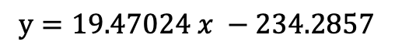
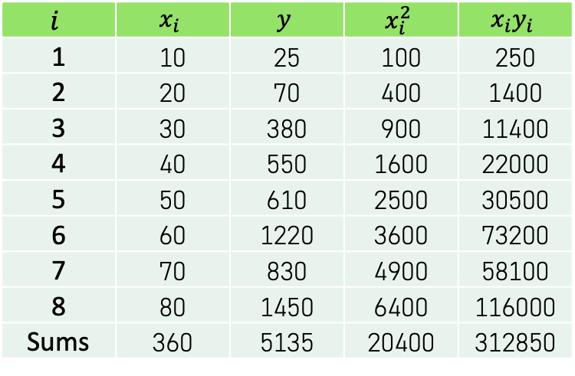
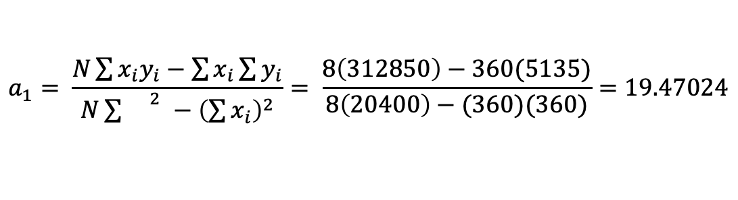
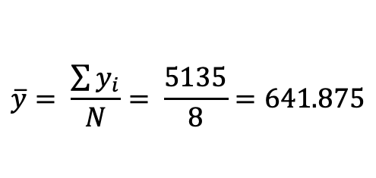
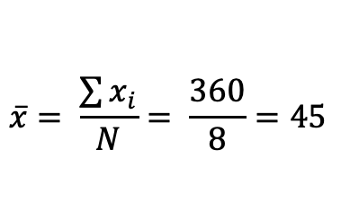
Example: Linear Least Squares Regression
$$i$$ | $$x_{i}$$ | $$y$$ | $$x_{i}^{2}$$ | $$x_{i}y_{i}$$
1 | 10 | 25 | 100 | 250
2 | 20 | 70 | 400 | 1400
3 | 30 | 380 | 900 | 11400
4 | 40 | 550 | 1600 | 22000
5 | 50 | 610 | 2500 | 30500
6 | 60 | 1220 | 3600 | 73200
7 | 70 | 830 | 4900 | 58100
8 | 80 | 1450 | 6400 | 116000
Sums | 360 | 5135 | 20400 | 312850
$$\overline{x}= \frac{\sum{x_{i}}}{N}= \frac{360}{8}=45$$
$$\overline{y}= \frac{\sum{y_{i}}}{N}= \frac{5135}{8}=641.875$$
$$a_{1}= \frac{N\sum{x_{i}y_{i}}−\sum{x_{i}}\sum{y_{i}}}{N\sum{{}_{}^{2}}−{\left(\sum{x_{i}}\right)}^{2}}= \frac{8\left(312850\right)−360(5135)}{8\left(20400\right)−(360)(360)}=19.47024$$
$$y=19.47024 x −234.2857$$
$$a_{0}=\overline{y}−a_{1}\overline{x}=\left(641.875\right)−\left(19.47024\right)\left(45\right)=−234.2857$$

Slide 9
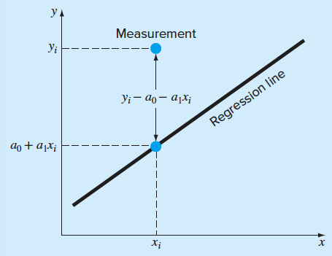
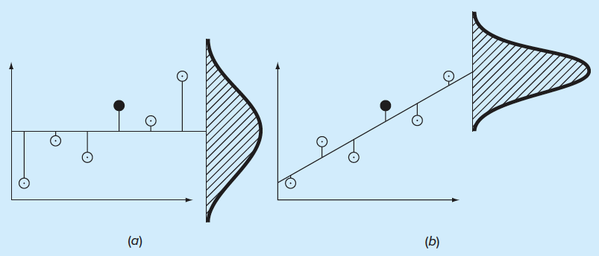
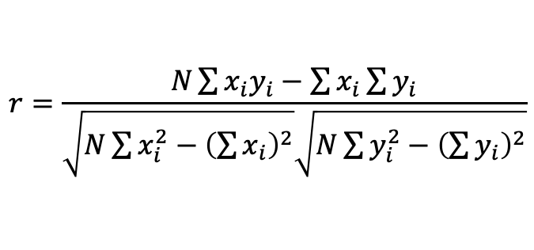
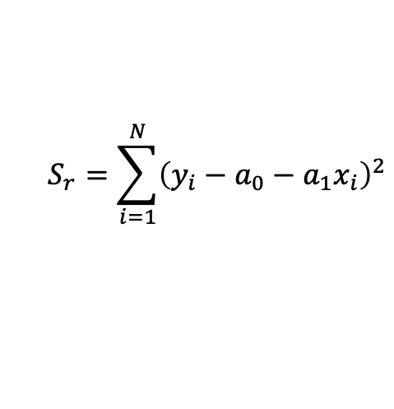
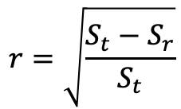
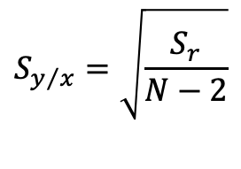
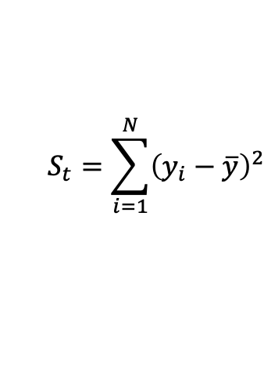
How Good is the Fitness / Regressions? – Error Estimate
$$S_{t}=\sum_{i=1}^{N}{{\left(y_{i}−\overline{y}\right)}^{2}}$$
$$S_{r}=\sum_{i=1}^{N}{{\left(y_{i}−a_{0}−a_{1}x_{i}\right)}^{2}}$$
Measures
Spread around the mean
Measures
Spread around the regression line
Standard Error of the estimate
$$S_{y/x}=\sqrt{\frac{S_{r}}{N−2}}$$
Correlation Coefficient
$$r=\sqrt{\frac{S_{t}−S_{r}}{S_{t}}}$$
$$r=\frac{N\sum{x_{i}y_{i}}−\sum{x_{i}}\sum{y_{i}}}{\sqrt{N\sum{x_{i}^{2}}−{\left(\sum{x_{i}}\right)}^{2}}\sqrt{N\sum{y_{i}^{2}}−{\left(\sum{y_{i}}\right)}^{2}}}$$

Slide 10
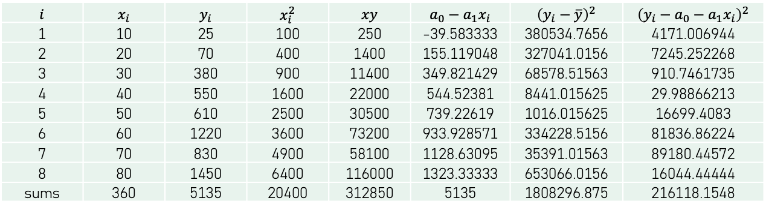
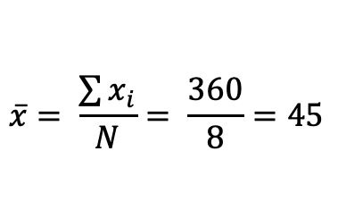
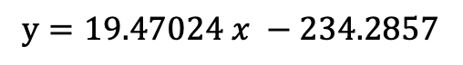
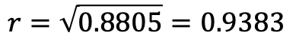
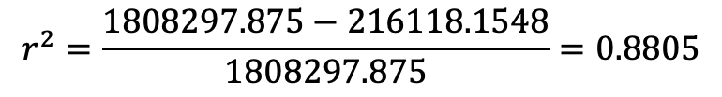
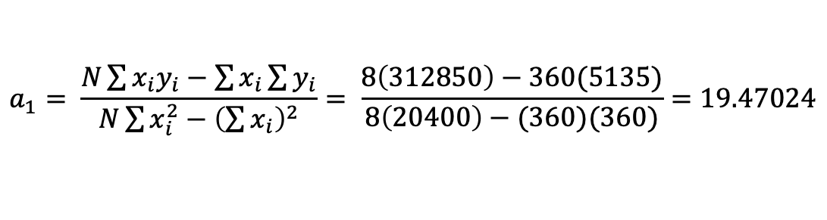
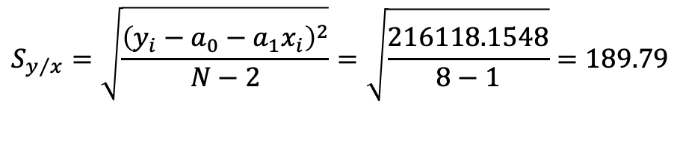
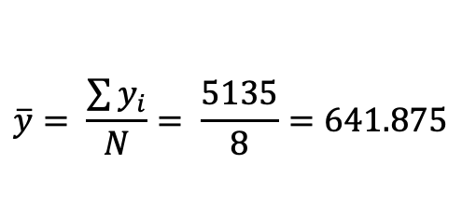

Example: Estimation of Errors for the Linear Least Squares Fit
$$i$$ | $$x_{i}$$ | $$y_{i}$$ | $$x_{i}^{2}$$ | $$xy$$ | $$a_{0}−a_{1}x_{i}$$ | $${\left(y_{i}−\overline{y}\right)}^{2}$$ | $${\left(y_{i}−a_{0}−a_{1}x_{i}\right)}^{2}$$
1 | 10 | 25 | 100 | 250 | -39.583333 | 380534.7656 | 4171.006944
2 | 20 | 70 | 400 | 1400 | 155.119048 | 327041.0156 | 7245.252268
3 | 30 | 380 | 900 | 11400 | 349.821429 | 68578.51563 | 910.7461735
4 | 40 | 550 | 1600 | 22000 | 544.52381 | 8441.015625 | 29.98866213
5 | 50 | 610 | 2500 | 30500 | 739.22619 | 1016.015625 | 16699.4083
6 | 60 | 1220 | 3600 | 73200 | 933.928571 | 334228.5156 | 81836.86224
7 | 70 | 830 | 4900 | 58100 | 1128.63095 | 35391.01563 | 89180.44572
8 | 80 | 1450 | 6400 | 116000 | 1323.33333 | 653066.0156 | 16044.44444
sums | 360 | 5135 | 20400 | 312850 | 5135 | 1808296.875 | 216118.1548
$$\overline{x}= \frac{\sum{x_{i}}}{N}= \frac{360}{8}=45$$
$$\overline{y}= \frac{\sum{y_{i}}}{N}= \frac{5135}{8}=641.875$$
$$a_{1}= \frac{N\sum{x_{i}y_{i}}−\sum{x_{i}}\sum{y_{i}}}{N\sum{x_{i}^{2}}−{\left(\sum{x_{i}}\right)}^{2}}= \frac{8\left(312850\right)−360(5135)}{8\left(20400\right)−(360)(360)}=19.47024$$
$$y=19.47024 x −234.2857$$
$$a_{0}=\overline{y}−a_{1}\overline{x}=\left(641.875\right)−\left(19.47024\right)\left(45\right)=−234.2857$$
Standard deviation (spread) from the mean:
Standard error (spread) around the regression line (estimate):
$$S_{y}=\sqrt{\frac{{\left(y_{i}−\overline{y}\right)}^{2}}{N−1}}=\sqrt{\frac{\text{1808297.875}}{8−1}}=508.26$$
$$S_{y/x}=\sqrt{\frac{{\left(y_{i}−a_{0}−a_{1}x_{i}\right)}^{2}}{N−2}}=\sqrt{\frac{\text{216118.1548}}{8−1}}=189.79$$
$$r^{2}=\frac{\text{1808297.875}−\text{216118.1548}}{\text{1808297.875}}=0.8805$$
$$r=\sqrt{0.8805}=0.9383$$
88.05% of the original data has been explained by the linear model.

Slide 11


How good is the coefficient of variance for goodness-of-fit?
All of these four data sets have the same best-fit line $y=3+0.5x$ and
same coefficient of variance (determination) $r^{2}=0.67!$
Graphical inspection of
the data is important. It can
help decide what type of
curve can be used for the
regression analysis.

Slide 12












Linearization of Nonlinear Relationships
Exponential
Power equation
Saturation growth-rate equation
$$y= α_{1}e^{β_{1}x}$$
$$y= α_{2}x^{β_{2}}$$
$$y= α_{3}\frac{x}{β_{3}+x}$$
Linearization
Linearization
Linearization
$$\log{y}=\log{α_{1}}+β_{2}\log{x}$$
$$\frac{1}{y}= \frac{1}{α_{3}}+\frac{β_{3}}{α_{3}} \frac{1}{x}$$
$$\ln{y}=\ln{α_{1}}+β_{1}x$$

Slide 13











Example: Fitting Data with the Power Equation – $y=α x^{β} ⇒\log{y}=\log{α}+β\log{x}$
$$i$$ | $$x_{i}$$ | $$y_{i}$$ | $$\log{x_{i}}$$ | $$\log{y_{i}}$$ | $${\left(\log{x_{i}}\right)}^{2}{ }$$ | $$\log{x_{i}}\log{x_{i}}$$
1 | 10 | 25 | 1 | 1.39794001 | 1 | 1.39794001
2 | 20 | 70 | 1.30103 | 1.84509804 | 1.69267905 | 2.40052789
3 | 30 | 380 | 1.47712125 | 2.5797836 | 2.1818872 | 3.81065318
4 | 40 | 550 | 1.60205999 | 2.74036269 | 2.56659622 | 4.39022543
5 | 50 | 610 | 1.69897 | 2.78532984 | 2.88649908 | 4.73219184
6 | 60 | 1220 | 1.77815125 | 3.08635983 | 3.16182187 | 5.48801459
7 | 70 | 830 | 1.84509804 | 2.91907809 | 3.40438678 | 5.38598527
8 | 80 | 1450 | 1.90308999 | 3.161368 | 3.6217515 | 6.01636779
Sums | 360 | 5135 | 12.6055205 | 20.5153201 | 20.5156217 | 33.621906
$$\log{y}=−0.5620+1.9842\log{x}$$
$$\overline{x}= \frac{12.606}{8}=1.5757$$
$$\overline{y}= \frac{20.515}{8}=2.5644$$
$${y= 0.2741x}^{1.9842}$$
$$a_{1}= \frac{8\left(33.622\right)−12.606(20.515)}{8\left(20.516\right)−(12.606)(12.606)}=1.9842$$
$$\log{y}=−0.5620+1.9842\log{x}$$
$$a_{0}=\left(2.5644\right)−\left(1.9842\right)\left(1.5757\right)=−0.5620$$
$$\log{y}=−0.5620+1.9842\log{x}$$
$$\log{y}=−0.5620\log{10}+1.9842\log{x}$$
$$\log{y}=\log{{10}^{−0.5620}}+\log{x^{1.9842}}$$
$$\log{y}=\log{0.2741}+\log{x^{1.9842}=\log{0.2741}}x^{1.9842}$$
$${y= 0.2741x}^{1.9842}$$

Slide 14













Polynomial Regression
$$y=a_{0}+a_{1}x+a_{2}x^{2}+e$$
$$S_{r}=\sum_{i=1}^{N}{{\left(e_{i}\right)}^{2}}=\sum_{i=1}^{N}{{\left(y_{i}−a_{0}−a_{1}x_{i}−a_{2}x_{i}^{2}\right)}^{2}}$$
Sum of the squares of the residuals
Take derivatives w.r.t. the unknows
$$\frac{∂S_{r}}{∂a_{0}}=−2\sum{\left(y_{i}−a_{0}−a_{1}x_{i}−a_{2}x_{i}^{2}\right)}$$
$$\frac{∂S_{r}}{∂a_{1}}=−2\sum{\left(y_{i}−a_{0}−a_{1}x_{i}−a_{2}x_{i}^{2}\right)x_{i}}$$
$$\frac{∂S_{r}}{∂a_{2}}=−2\sum{\left(y_{i}−a_{0}−a_{1}x_{i}−a_{2}x_{i}^{2}\right)x_{i}^{2}}$$
Set equal to zero and rearrange to give the normal equations
$${\left(N\right)a}_{0}+\left(\sum{x_{i}}\right)a_{1}+\left(\sum{x_{i}^{2}}\right)a_{2}=\sum{y_{i}}$$
$\left[\begin{matrix}N & \sum{x_{i}} & \sum{x_{i}^{2}} \\ \sum{x_{i}} & \sum{x_{i}^{2}} & \sum{x_{i}^{3}} \\ \sum{x_{i}^{2}} & \sum{x_{i}^{3}} & \sum{x_{i}^{4}}\end{matrix}\right]\left\{\begin{matrix}a_{0} \\ a_{1} \\ a_{2}\end{matrix}\right\}$= $\left\{\begin{matrix}\sum{y_{i}} \\ \sum{x_{i}y_{i}} \\ \sum{x_{i}^{2}y_{i}}\end{matrix}\right\}$
$${\left(\sum{x_{i}}\right)a}_{0}+\left(\sum{x_{i}^{2}}\right)a_{1}+\left(\sum{x_{i}^{3}}\right)a_{2}=\sum{x_{i}y_{i}}$$
$${\left(\sum{x_{i}^{2}}\right)a}_{0}+\left(\sum{x_{i}^{3}}\right)a_{1}+\left(\sum{x_{i}^{4}}\right)a_{2}=\sum{x_{i}^{2}y_{i}}$$
The method can be extended for a polynomial of mth-order:
$$y=a_{0}+a_{1}x+a_{2}x^{2}+⋯+a_{m}x^{m}+e$$
Given the data, we can end up solving m-simultaneous linear equations in m unknowns.
The standard error and correlation coefficient are given by ($S_{t}$ being the spread around the mean):
Figure 15.1: (a) Data that are ill-suited for linear least-squares
regression. (b) Indication that a parabola is preferable.
$$S_{y/x}=\sqrt{\frac{S_{r}}{N−(m+1) }}$$
$$r=\sqrt{\frac{S_{t}−S_{r}}{S_{t}}}$$

Slide 15








Example: Polynomial Regression
Fitting a quadratic (parabolic) polynomial
$$y=a_{0}+a_{1}x+a_{2}x^{2}$$
$$i$$ | $$x_{i}$$ | $$y_{i}$$ | $$x_{i}^{2}$$ | $$x_{i}^{3}$$ | $$x_{i}^{4}$$ | $$x_{i}y_{i}$$ | $$x_{i}^{2}y_{i}$$ | $$\left(y_{i}−\overline{y}\right)$$ | $${\left(y_{i}−\overline{y}\right)}^{2}$$
1 | 0 | 2.1 | 0 | 0 | 0 | 0 | 0 | -23.33 | 544.44
2 | 1 | 7.7 | 1 | 1 | 1 | 7.7 | 7.7 | -17.73 | 314.47
3 | 2 | 13.6 | 4 | 8 | 16 | 27.2 | 54.4 | -11.83 | 140.03
4 | 3 | 27.2 | 9 | 27 | 81 | 81.6 | 244.8 | 1.77 | 3.12
5 | 4 | 40.9 | 16 | 64 | 256 | 163.6 | 654.4 | 15.47 | 239.22
6 | 5 | 61.1 | 25 | 125 | 625 | 305.5 | 1527.5 | 35.67 | 1272.11
sums | 15 | 152.6 | 55 | 225 | 979 | 585.6 | 2488.8 | 0 | 2513.39
The normal equations for a quadratic polynomial regression are given by
$\left[\begin{matrix}N & \sum{x_{i}} & \sum{x_{i}^{2}} \\ \sum{x_{i}} & \sum{x_{i}^{2}} & \sum{x_{i}^{3}} \\ \sum{x_{i}^{2}} & \sum{x_{i}^{3}} & \sum{x_{i}^{4}}\end{matrix}\right]\left\{\begin{matrix}a_{0} \\ a_{1} \\ a_{2}\end{matrix}\right\}$= $\left\{\begin{matrix}\sum{y_{i}} \\ \sum{x_{i}y_{i}} \\ \sum{x_{i}^{2}y_{i}}\end{matrix}\right\}$
$\left[\begin{matrix}6 & 15 & 55 \\ 15 & 55 & 255 \\ 55 & 255 & 979\end{matrix}\right]\left\{\begin{matrix}a_{0} \\ a_{1} \\ a_{2}\end{matrix}\right\}$= $\left\{\begin{matrix}152.6 \\ 585.6 \\ 2488.8\end{matrix}\right\}$
Using MATLAB
$$S_{y/x}=\sqrt{\frac{S_{r}}{N−(m+1) }}=\sqrt{\frac{3.74657}{6−(2+1) }}=1.1175$$
$$y=2.4786+2.3593 x+1.8607 x^{2}$$
$$r=\sqrt{\frac{S_{t}−S_{r}}{S_{t}}}=\sqrt{\frac{2513.39−3.74657}{2513.39}}=0.9975$$

Slide 17















Multiple Linear Regression
$$y=a_{0}+a_{1}x_{1}+a_{2}x_{2}+e$$
$$S_{r}=\sum_{i=1}^{N}{{\left(e_{i}\right)}^{2}}=\sum_{i=1}^{N}{{\left(y_{i}−a_{0}−a_{1}x_{1}−a_{2}x_{2}\right)}^{2}}$$
Sum of the squares of the residuals
Take derivatives w.r.t the unknows
$$\frac{∂S_{r}}{∂a_{0}}=−2\sum{\left(y_{i}−a_{0}−a_{1}x_{1,i}−a_{2}x_{2,i}\right)}$$
$$\frac{∂S_{r}}{∂a_{1}}=−2\sum{\left(y_{i}−a_{0}−a_{1}x_{1,i}−a_{2}x_{2,i}\right)x_{1,i}}$$
$$\frac{∂S_{r}}{∂a_{2}}=−2\sum{\left(y_{i}−a_{0}−a_{1}x_{1,i}−a_{2}x_{2,i}\right)x_{2,i}}$$
Set equal to zero and rearrange to give the normal equations
$${\left(N\right)a}_{0}+\left(\sum{x_{1,i}}\right)a_{1}+\left(\sum{x_{2,i}}\right)a_{2}=\sum{y_{i}}$$
Figure 15.3: Graphical depiction of multiple linear regression
where $y$ is a linear function of $x_{1}$ and $x_{2}$.
$${\left(\sum{x_{1,i}}\right)a}_{0}+\left(\sum{x_{1,i}^{2}}\right)a_{1}+\left(\sum{x_{1,i}x_{2,i}}\right)a_{2}=\sum{x_{1,i}y_{i}}$$
$\left[\begin{matrix}N & \sum{x_{1,i}} & \sum{x_{2,i}} \\ \sum{x_{1,i}} & \sum{x_{1,i}^{2}} & \sum{x_{1,i}x_{2,i}} \\ \sum{x_{1,i}^{2}} & \sum{x_{1,i}x_{2,i}} & \sum{x_{2,i}^{2}}\end{matrix}\right]\left\{\begin{matrix}a_{0} \\ a_{1} \\ a_{2}\end{matrix}\right\}$= $\left\{\begin{matrix}\sum{y_{i}} \\ \sum{x_{1,i}y_{i}} \\ \sum{x_{2,i}y_{i}}\end{matrix}\right\}$
$${\left(\sum{x_{1,i}^{2}}\right)a}_{0}+\left(\sum{x_{1,i}x_{2,i}}\right)a_{1}+\left(\sum{x_{2,i}^{2}}\right)a_{2}=\sum{x_{2,i}y_{i}}$$
The method can be extended for m-dimensions:
$$y=a_{0}+a_{1}x_{1}+a_{2}x_{2}+⋯+a_{m}x_{m}+e$$
Note
For a general power equations regression:
$$y=a_{0}x_{1}^{a_{1}}x_{2}^{a_{2}}⋯x_{m}^{a_{m}}$$
We can take logarithms to convert and use the multi-dimensional linear regression:
$$\log{y}=\log{a_{0}}+a_{1}\log{x_{1}}+a_{2}\log{x_{2}}+⋯+a_{m}\log{x_{m}}$$
Given the data, we can end up solving m-simultaneous linear equations in m unknowns. The standard error and correlation coefficient are given by ($S_{t}$ being the spread around the mean):
$$S_{y/x}=\sqrt{\frac{S_{r}}{N−(m+1) }}$$
$$r=\sqrt{\frac{S_{t}−S_{r}}{S_{t}}}$$

Slide 18






Example: Multiple Linear Regression
Fitting a two-dimensional linear polynomial
$$y=a_{0}+a_{1}x_{1}+a_{2}x_{2}$$
$$i$$ | $$y$$ | $$x_{1}$$ | $$x_{2}$$ | $$x_{1}^{2}$$ | $$x_{2}^{2}$$ | $$x_{1}x_{2}$$ | $$x_{1}y$$ | $$x_{1}y$$
1 | 5 | 0 | 0 | 0 | 0 | 0 | 0 | 0.00
2 | 10 | 2 | 1 | 4 | 1 | 2 | 20 | 10.00
3 | 9 | 2.5 | 2 | 6.25 | 4 | 5 | 22.5 | 18.00
4 | 0 | 1 | 3 | 1 | 9 | 3 | 0 | 0.00
5 | 3 | 4 | 6 | 16 | 36 | 24 | 12 | 18.00
6 | 27 | 7 | 2 | 49 | 4 | 14 | 189 | 54.00
Sums | 54 | 16.5 | 14 | 76.25 | 54 | 48 | 243.5 | 100
The data has been generated using
$$y=5+4x_{1}−3x_{2}$$
The normal equations for the two-dimensional linear regression are given by
$\left[\begin{matrix}N & \sum{x_{1,i}} & \sum{x_{2,i}} \\ \sum{x_{1,i}} & \sum{x_{1,i}^{2}} & \sum{x_{1,i}x_{2,i}} \\ \sum{x_{1,i}^{2}} & \sum{x_{1,i}x_{2,i}} & \sum{x_{2,i}^{2}}\end{matrix}\right]\left\{\begin{matrix}a_{0} \\ a_{1} \\ a_{2}\end{matrix}\right\}$= $\left\{\begin{matrix}\sum{y_{i}} \\ \sum{x_{1,i}y_{i}} \\ \sum{x_{2,i}y_{i}}\end{matrix}\right\}$
$\left[\begin{matrix}6 & 16.5 & 14 \\ 16.5 & 76.25 & 48 \\ 14 & 48 & 54\end{matrix}\right]\left\{\begin{matrix}a_{0} \\ a_{1} \\ a_{2}\end{matrix}\right\}$= $\left\{\begin{matrix}54 \\ 243.5 \\ 100\end{matrix}\right\}$
Using MATLAB
>> matA = [6 16.5 14; 16.5 76.25 48; 14 48 54];
>> vecb = [54; 243.5; 100];
>> a = matA\vecb
a
5.000
4.000
-3.000
$$y=5+4x_{1}−3x_{2}$$

Slide 19







General Linear Least Squares
$$y=a_{0}z_{0}+a_{1}z_{1}+a_{2}z_{2}+⋯+a_{m}z_{m}+e$$
General linear least squares model with $z_{0},z_{1}, …,z_{m}$ basis functions.
With $z_{0}=1,z_{1}=x,$ basis functions, we have simple linear regression.
With $z_{0}=1,z_{1}=x_{1}, …,z_{m}=x_{m}$basis functions, we have multi-dimensional linear regression.
With $z_{0}=1,z_{1}=x,z_{2}=x^{2}$basis functions, we have linear regression with a quadratic polynomial.
With $z_{0}=1,z_{1}=x,z_{2}=x^{2}$ $,…, z_{m}=x^{m}$basis functions, we have linear regression with an mth order polynomial.
The terminology “linear” means that the model’s dependence on its parameters – that is $a_{0},a_{1}, …,a_{m}$- is linear. The $z^{′}s$ could be
highly nonlinear (as in case of a polynomials). For example, the $z^{′}s$ can be sinusoids, such that
$$y=a_{0}+a_{1}\sin\left(ωx\right)+a_{2}\cos\left(ωx\right)+e$$
Example of a nonlinear model could be ${y=a}_{0}\left(1−e^{a_{1}x}\right)$, where the parameters $a^{′}s$ do not form a linear combination.
The general linear least squares model $y=a_{0}z_{0}+a_{1}z_{1}+a_{2}z_{2}+⋯+a_{m}z_{m}+e$ can be written in matrix form (for all data values) as:
$$\left\{y\right\}=\left[Z\right]\left\{a\right\}+\left\{e\right\}$$
The matrix $\left[Z\right]$ is formed by calculating the values of the basis functions at the measured values of the independent variables:
$$\left[Z\right]=\left[\begin{matrix}\begin{matrix}z_{01} & z_{11} \\ z_{02} & z_{22}\end{matrix} & ⋯ & \begin{matrix}z_{m1} \\ z_{m1}\end{matrix} \\ ⋮ & ⋱ & ⋮ \\ \begin{matrix}z_{0n} & z_{2n}\end{matrix} & ⋯ & z_{mn}\end{matrix}\right]$$
$$\left[y\right]=\left[\begin{matrix}\begin{matrix}y_{1} \\ y_{2}\end{matrix} \\ ⋮ \\ y_{n}\end{matrix}\right]$$
$$\left[a\right]=\left[\begin{matrix}\begin{matrix}a_{0} \\ a_{1}\end{matrix} \\ ⋮ \\ a_{m}\end{matrix}\right]$$
$$\left[e\right]=\left[\begin{matrix}\begin{matrix}e_{1} \\ e_{2}\end{matrix} \\ ⋮ \\ e_{n}\end{matrix}\right]$$
The sum of the squares of the residuals / errors in this case is:
$$S_{r}=\sum_{i=1}^{N}{{\left(e_{i}\right)}^{2}}=\sum_{i=1}^{N}{{\left(y_{i}−\sum_{j=0}^{n}{a_{j}z_{ji}}\right)}^{2}}$$
Minimization
$$\left[{\left[Z\right]}^{T}\left[Z\right]\right]\left\{a\right\}=\left\{{\left[Z\right]}^{T}\left\{y\right\}\right\}$$

Slide 20
Some Important Concepts
Underfitting, Optimal Fitting and Overfitting
Validation
Feature Selection
Regularization

Slide 21
Underfitting
The model performs poorly for the training as well as the test data.
Example: Fitting a linear regression model for a non-linear data.
Overfitting
The model performs very well for the training but poorly for the test data.
Example: Say 95% accuracy for training data, but 55% for test data in a
classification problem.

Slide 22
Performs well
on test dataset
Performs well
on training dataset
No
No
Model
Underfitting
Yes
Yes
Good Model
Overfitting

Slide 23
Overfitting: Key Definitions
Bias
Measures the difference between the model prediction and the target value.
Oversimplified model can result in predictions far from the ground truth,
and high bias (an indicator of underfitting).
Variance
Measures the inconsistency of different predictions of the model over
different datasets. If the model performance is tested on different datasets,
the closer the predictions, the lesser the variance, High variance is an indicator
of overfitting
Feature Selection
Out of all the extracted features that may contribute toward
the model performance, selecting a subset of features that contribute most.
This involves elimination of redundant features, leading to reduction in training
time and reduction in the model complexity.

Slide 24
Bias
Measures the difference between the model prediction and the target value.
Oversimplified model can result in predictions far from the ground truth,
and high bias (an indicator of underfitting).
Variance
Measures the inconsistency of different predictions of the model over
different datasets. If the model performance is tested on different datasets,
the closer the predictions, the lesser the variance, High variance is an indicator
of overfitting

Slide 25
Overfitting: How to avoid?
Train with more data – can help the model to recognize the relationship between the input attributes and the output.
Data Augmentation: Make the samples slightly different every time model processes it.
Addition of Noise to the Input Data: Like augmentation. Added noise should be small. Adding too much noise can make the data incorrect.
Feature Selection
Cross-Validation: Most robust measure to prevent overfitting.
Regularization: Penalizes model parameters that lead to larger error/loss.
Using an Ensemble: Combine several models to produce one optimal model.
Early Stopping: This helps in avoiding the model from memorizing the data / noise. Too early stopping can sometime lead to underfitting.
Adding Dropout Layers: In a neural network, some neurons are randomly dropped out to help reduce overfitting.

Slide 26

K-fold Cross-Validation
Most popular technique used to detect overfitting.
Split the training data into K equally sized subsets called K-folds.
One subset acts the testing set and remaining folds are used to train the model.

Slide 27
Features
In machine learning, a feature is an input variable given to the ML model.
Two types of features: (1) Numerical, (2) Categorical
Categorical features can be converted to numerical features using techniques
such as one-hot encoding or label encoding etc.
What are most important, significant features for
solving a ML problem?
Feature Selection
Features Engineering
Filter
Methods
Wrapper
Methods
Embedded
Methods

Slide 28

Feature Selection
Filter Methods:
Act as pre-processing step before applying ML algorithms.
They are computationally fast and inexpensive.
Good in removing duplicated, correlated, redundant features.
Information Gain – determine entropy values (to measure information)
Chi-Square Test - $χ^{2}=\sum{{{\left(\text{observed} \text{value} – \text{expected} \text{value}\right)}^{2}}/{expected value}}$
Fisher Score: Maximum likelihood criterion
Correlation Coefficient
Variance Threshold – zero/small variance features are removed
Mean Absolute Difference – similar to variance threshold, no square in formula
Dispersion Ratio – ratio of arithmetic mean to that of geometric mean (AM/GM). Higher ratio means more relevant feature
Set of all features
Select the best subset
Learning Algorithm
Performance

Slide 29
Feature Selection
Wrapper Methods
They are kind of greedy algorithms – working iteratively using subsets of features.
Computationally expensive but more accurate that filter methods.
Forward Selection - starts with an empty subset and then keeps on adding features and evaluating the model performance.
Backward Selection – opposite of forward selection; begins with all features and then keeps on removing one feature at a time.
Exhaustive Selection – A brute force method; All possible subsets are created. Best performing subset is selected.
Set of all features
Consider a subset
Learning Algorithm
Performance
Select the subset

Slide 30
Feature Selection
Embedded Methods
Feature selection algorithm is blended into the learning algorithm.
Regularization – L1 and L2 regularization
Tree-based Methods – Random forests
Set of all features
Consider a subset
Learning Algorithm
Performance
Select the subset

Slide 31

Regularization
Linear Models for Regression
$$\hat{y}=w_{0}+w_{1}x_{1}+w_{2}x_{2}+⋯++w_{p}x_{p}=\sum_{i=1}^{p}{w_{i}x_{i}+w_{0}}$$
Linear Regression (Method of Least Square): The loss function is the sum of squared errors (SSE) or residuals for $N$ samples in a training dataset.
$$𝓛_{SSE}=\sum_{n=1}^{N}{{\left(y_{n}−{\hat{y}}_{n}\right)}^{2}}=\sum_{n=1}^{N}{{\left(y_{n}−\left(wx_{n}+w_{0}\right)\right)}^{2}}$$
We can find the unknown weights using:
Normal equations – matrix inversion for convex optimization problems
$$w^{∗}={\left(X^{T}X\right)}^{−1}X^{T}Y$$
Gradient Descent
$$w^{s+1}=w^{s}−η∇𝓛\left(w^{s}\right)$$
The loss function $𝓛$ in this case is $𝓛_{SSE}$.

Slide 32

Regularization
Gradient Descent can be used as:
Over entire data set (Batch Gradient Descent)
$$w^{s+1}=w^{s}−η∇𝓛\left(w^{s}\right)=w^{s}−\frac{η}{N}\sum_{i=1}^{N}{∇𝓛_{i}\left(w^{s}\right)}$$
Stochastic Gradient Descent
$$w^{s+1}=w^{s}−∇𝓛_{i}\left(w^{s}\right)$$
Mini Gradient Descent
$$w^{s+1}=w^{s}−\frac{η}{B}\sum_{i=1}^{B}{∇𝓛_{i}\left(w^{s}\right)}$$
Problems / Issues with Regression based on the sum of squared errors (SSE) loss?
Very easily overfits -> Use regularization

Slide 33

Regularization
Ridge Regression
Add a penalty term to the least squared error loss:
$$𝓛_{Ridge}=𝓛_{SSE}+α\sum_{i=1}^{p}{{w_{i}}^{2}}=\sum_{n=1}^{N}{{\left(y_{n}−\left(wx_{n}+w_{0}\right)\right)}^{2}}+α\sum_{i=1}^{p}{{w_{i}}^{2}}$$
Model penalizes if it uses large coefficients / weights
This is called L2 regularization, as it used L2 norm $\sum_{i=1}^{p}{{w_{i}}^{2}}$
The penalty parameter $α$ can regulate the penalization. Large $α$ cause more regulation. Default value for $α$ is 1.
Closed form solution can be obtained using Cholesky factorization.
Gradient descent algorithm and its variants (including conjugate gradient CG method) can be used.
For small datasets, Cholesky factorization can be used. CG can be used for large datasets.

Slide 34

Regularization – Other Methods
Lasso (Least Absolute Shrinkage and Selection Operator
Add a different penalty term to the least squared error loss:
$$𝓛_{Lasso}=𝓛_{SSE}+α\sum_{i=1}^{p}{\left\lfloor w_{i}\right\rfloor }=\sum_{n=1}^{N}{{\left(y_{n}−\left(wx_{n}+w_{0}\right)\right)}^{2}}+α\sum_{i=1}^{p}{\left|w_{i}\right|}$$
Model penalizes if it uses large coefficients / weights
This is called L1 regularization, as it used L1 norm$\sum_{i=1}^{p}{\left|w_{i}\right|}$
The penalty parameter $α$ can regulate the penalization. Large $α$ cause more regulation. Default value for $α$ is 1.
$𝓛_{Lasso}$ is non-differentiable convex loss function.
No closed form solution.
Gradient descent algorithm which requires calculation of the gradients (partial derivations), cannot be performed.
Weights can be optimized using Coordinate Descent algorithm.

Slide 35

Regularization – Other Methods
Elastic Net
Add both L1 and L2 regularizations to the least squared error loss:
$$𝓛_{Elastic}=\sum_{n=1}^{N}{{\left(y_{n}−\left(wx_{n}+w_{0}\right)\right)}^{2}}+αρ\sum_{i=1}^{p}{\left|w_{i}\right|}+α\left(1−ρ\right)\sum_{i=1}^{p}{{w_{i}}^{2}}$$
$ρ$is the L1 ratio:
With $ρ=1$, $𝓛_{Elastic}=𝓛_{Lasso}$
With $ρ=0$, $𝓛_{Elastic}=𝓛_{Ridge}$
$0<ρ<1$ sets a trade-off between L1 and L2 norms.
Weights can be optimized using Coordinate Descent algorithm.

Slide 36
General Linear Least Squares Regression
$$y=a_{0}z_{0}+a_{1}z_{1}+a_{2}z_{2}+⋯+a_{m}z_{m}+e$$
General linear least squares model with $z_{0},z_{1}, …,z_{m}$ basis functions.
With $z_{0}=1,z_{1}=x,$ basis functions, we have simple linear regression.
With $z_{0}=1,z_{1}=x_{1}, …,z_{m}=x_{m}$basis functions, we have multi-dimensional linear regression.
With $z_{0}=1,z_{1}=x,z_{2}=x^{2}$basis functions, we have linear regression with a quadratic polynomial.
With $z_{0}=1,z_{1}=x,z_{2}=x^{2}$ $,…, z_{m}=x^{m}$basis functions, we have linear regression with an mth order polynomial.
The terminology “linear” means that the model’s dependence on its parameters – that is $a_{0},a_{1}, …,a_{m}$- is linear. The $z^{′}s$ could be
highly nonlinear (as in case of a polynomials). For example, the $z^{′}s$ can be sinusoids, such that
$$y=a_{0}+a_{1}\sin\left(ωx\right)+a_{2}\cos\left(ωx\right)+e$$
Example of a nonlinear model could be ${y=a}_{0}\left(1−e^{a_{1}x}\right)$, where the parameters $a^{′}s$ do not form a linear combination.
The general linear least squares model $y=a_{0}z_{0}+a_{1}z_{1}+a_{2}z_{2}+⋯+a_{m}z_{m}+e$ can be written in matrix form (for all data values) as:
$$\left\{y\right\}=\left[Z\right]\left\{a\right\}+\left\{e\right\}$$
The matrix $\left[Z\right]$ is formed by calculating the values of the basis functions at the measured values of the independent variables:
$$\left[Z\right]=\left[\begin{matrix}\begin{matrix}z_{01} & z_{11} \\ z_{02} & z_{22}\end{matrix} & ⋯ & \begin{matrix}z_{m1} \\ z_{m1}\end{matrix} \\ ⋮ & ⋱ & ⋮ \\ \begin{matrix}z_{0n} & z_{2n}\end{matrix} & ⋯ & z_{mn}\end{matrix}\right]$$
$$\left[y\right]=\left[\begin{matrix}\begin{matrix}y_{1} \\ y_{2}\end{matrix} \\ ⋮ \\ y_{n}\end{matrix}\right]$$
$$\left[a\right]=\left[\begin{matrix}\begin{matrix}a_{0} \\ a_{1}\end{matrix} \\ ⋮ \\ a_{m}\end{matrix}\right]$$
$$\left[e\right]=\left[\begin{matrix}\begin{matrix}e_{1} \\ e_{2}\end{matrix} \\ ⋮ \\ e_{n}\end{matrix}\right]$$
The sum of the squares of the residuals / errors in this case is:
$$S_{r}=\sum_{i=1}^{N}{{\left(e_{i}\right)}^{2}}=\sum_{i=1}^{N}{{\left(y_{i}−\sum_{j=0}^{n}{a_{j}z_{ji}}\right)}^{2}}$$
Minimization
$$\left[{\left[Z\right]}^{T}\left[Z\right]\right]\left\{a\right\}=\left\{{\left[Z\right]}^{T}\left\{y\right\}\right\}$$

